Slide 1


Slide 2
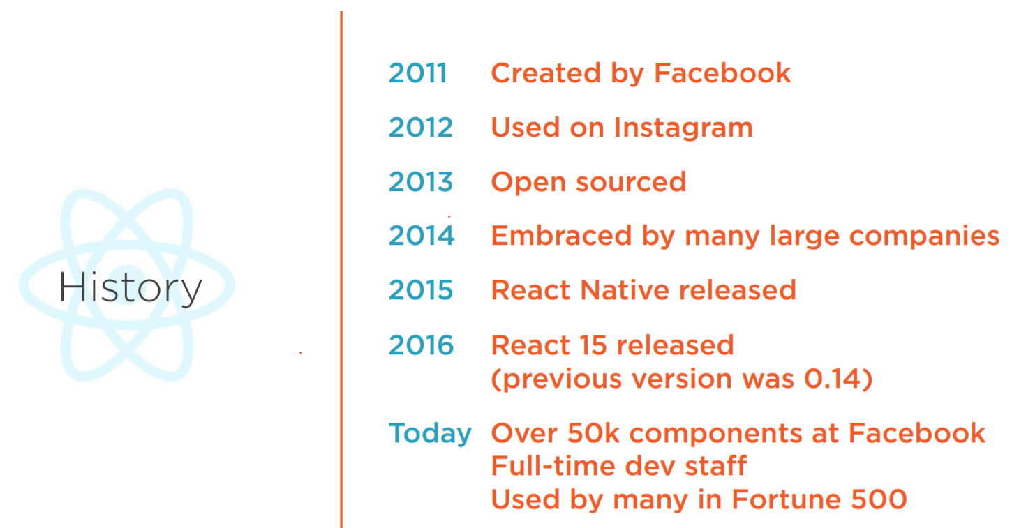

Slide 3


Slide 4


Slide 5
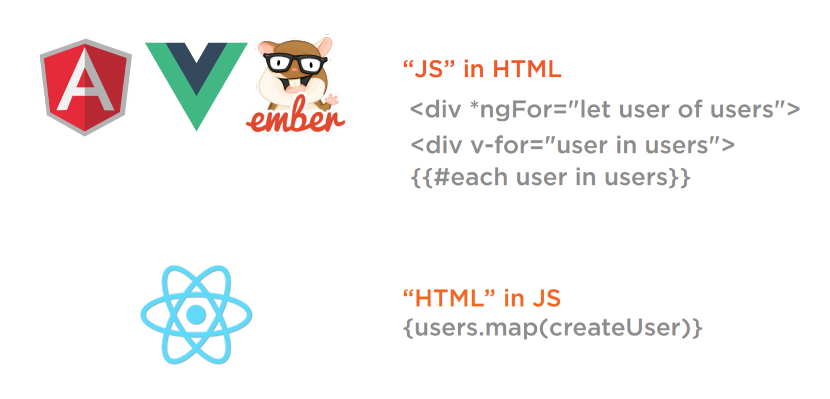

Slide 6
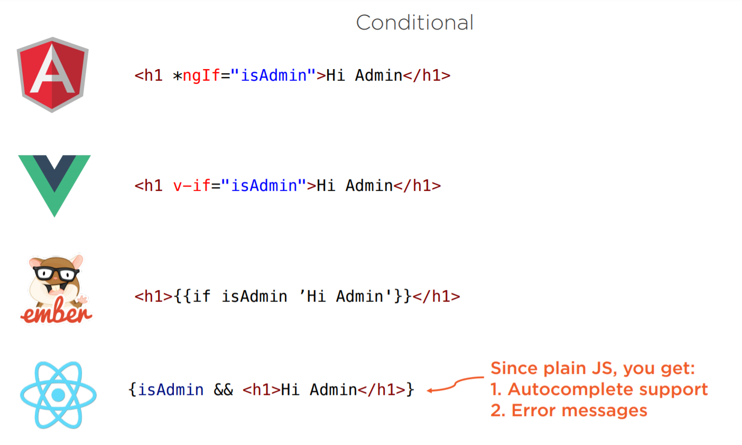

Slide 7
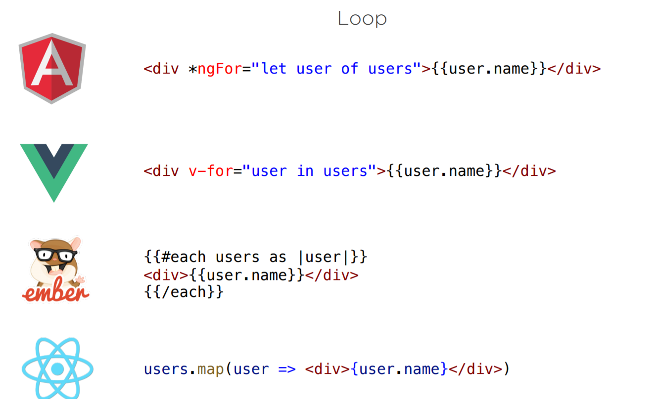

Slide 8
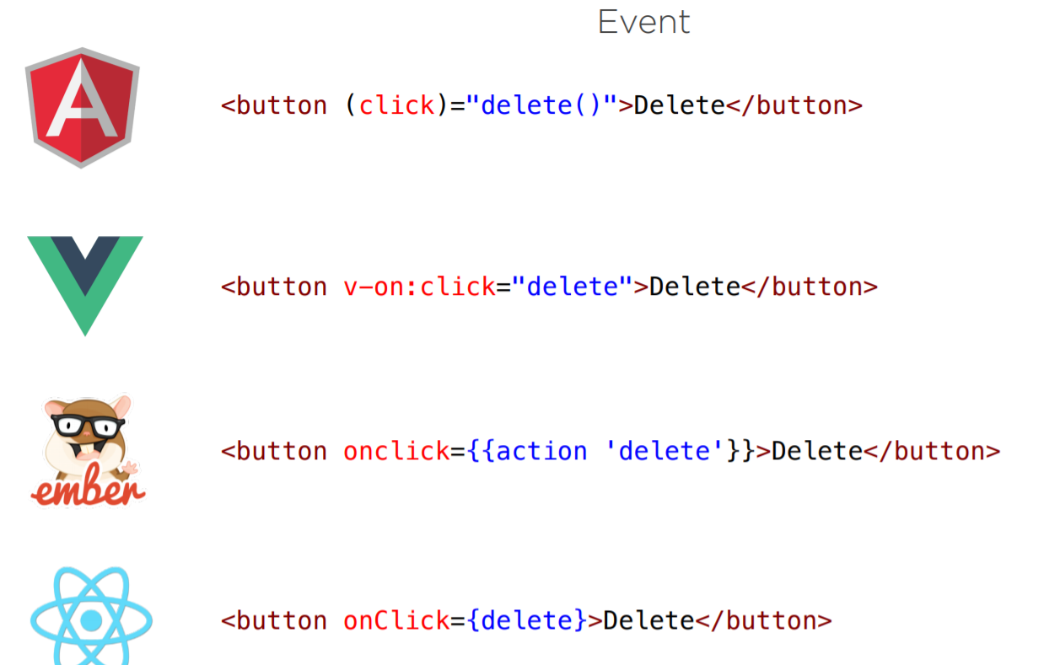

Slide 9
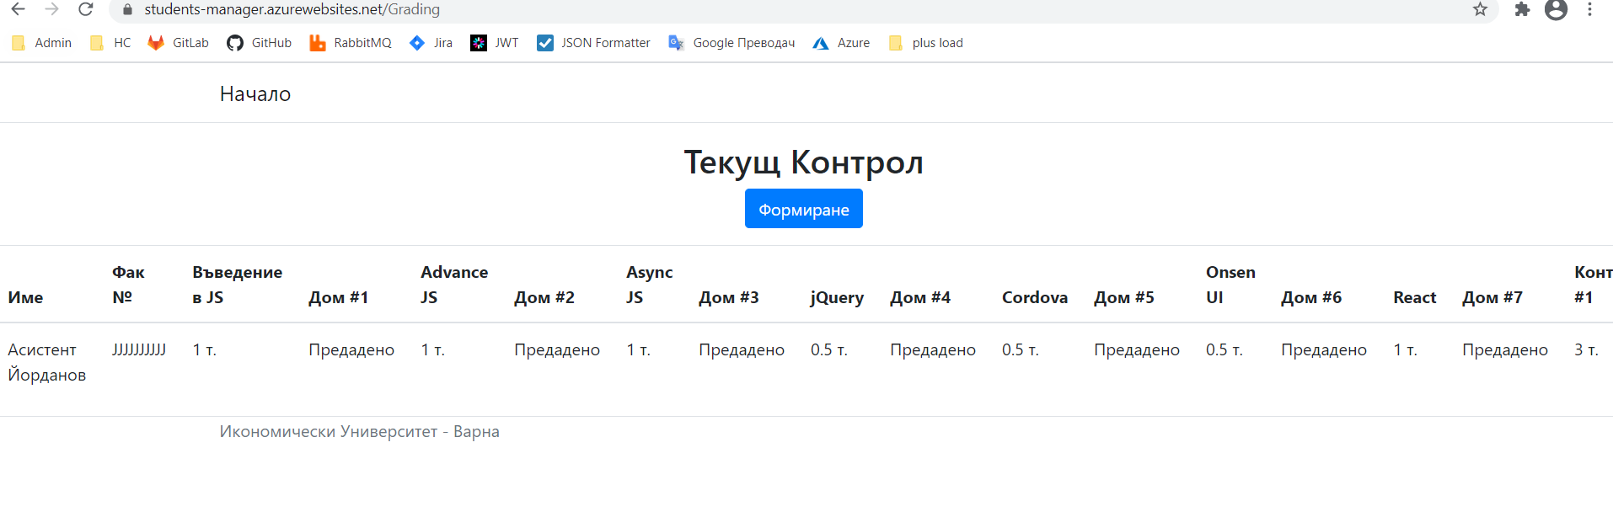
Replace Grading page with React

Slide 10

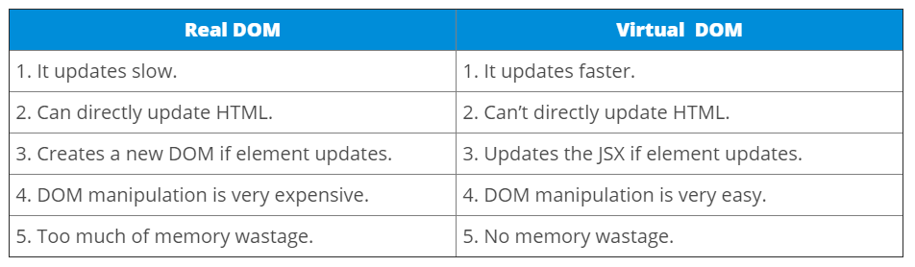

Slide 11
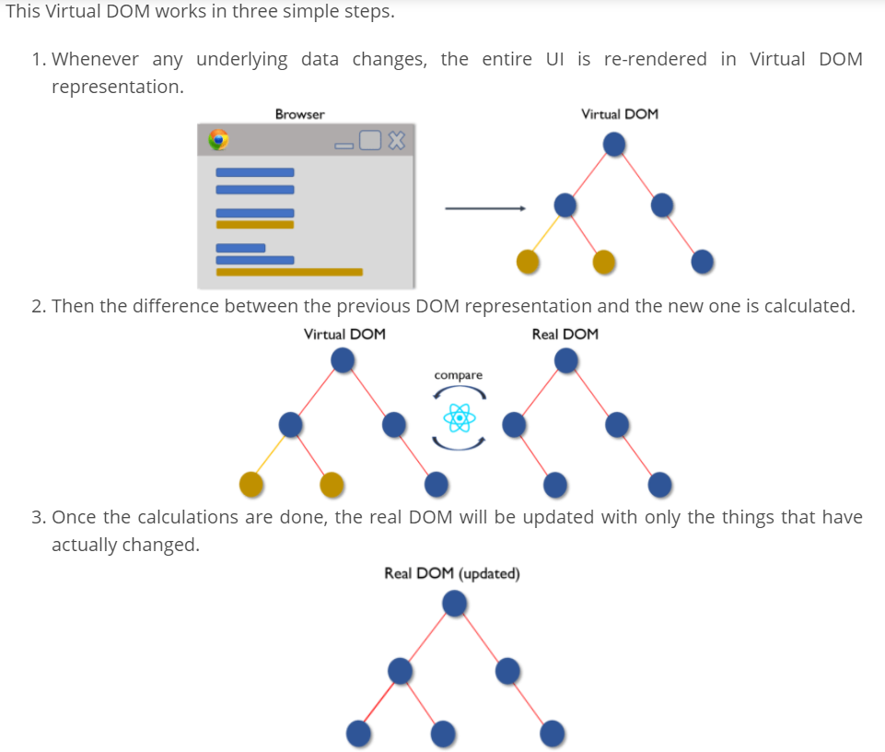

Slide 12
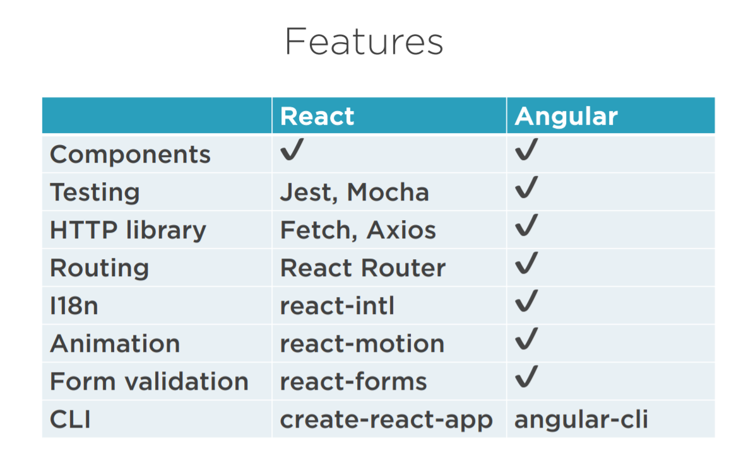

Slide 13
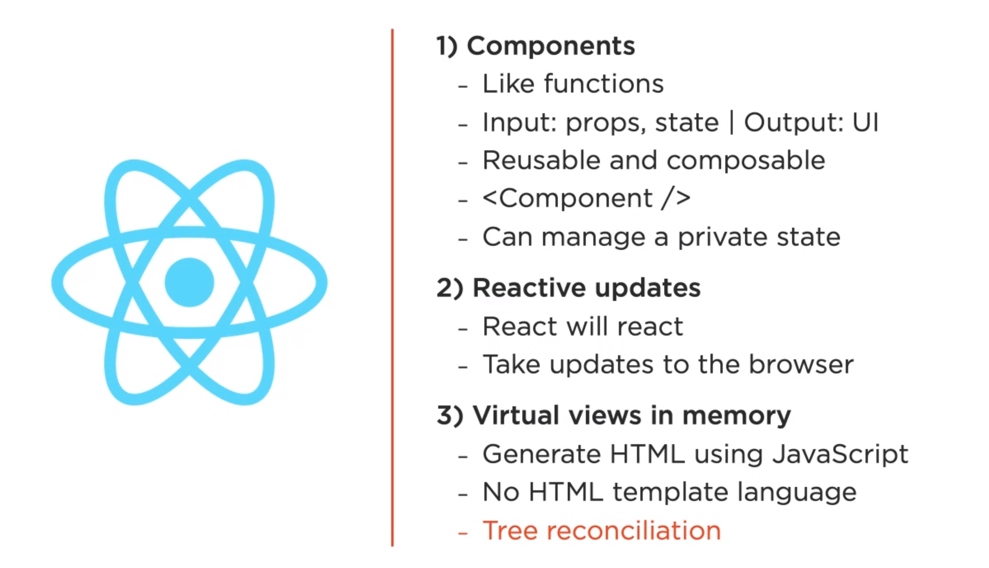

Slide 14
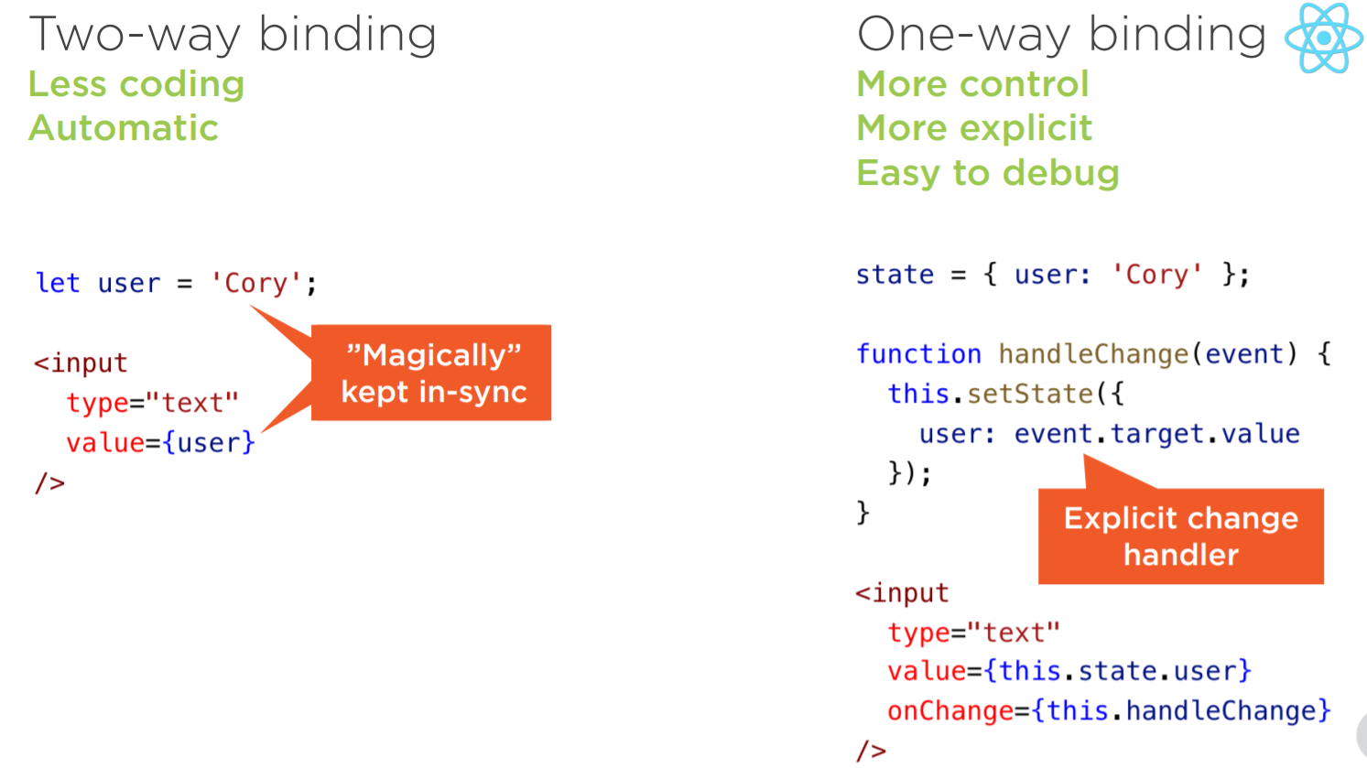

Slide 15
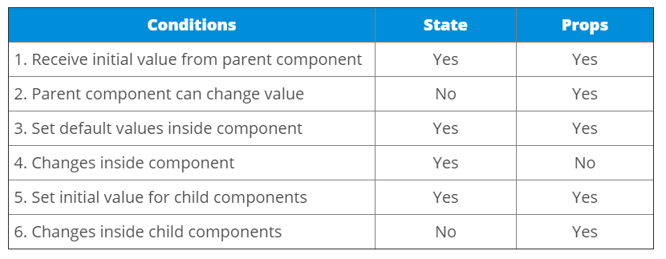
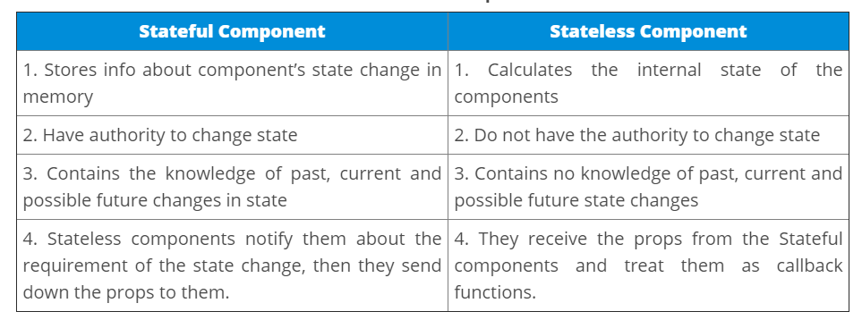

Slide 16
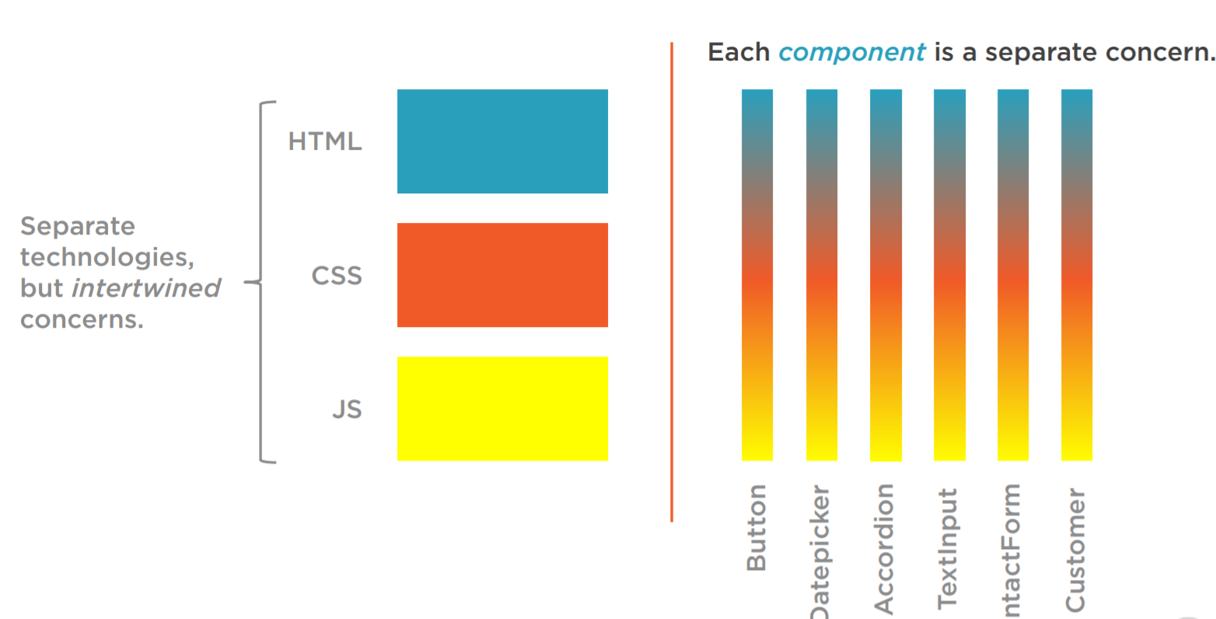

Slide 17
Playground
https://jscomplete.com/playground/rgs1.1
https://jscomplete.com/playground/rgs1.2
https://jscomplete.com/playground/rgs1.4
https://jscomplete.com/playground/rgs1.3
https://jscomplete.com/playground/rgs1.5
https://jscomplete.com/playground/rgs1.6
https://jscomplete.com/playground/rgs1.8
https://jscomplete.com/playground/scopes
https://jscomplete.com/playground/arrow-vs-regular-functions
https://jscomplete.com/playground/object-literals
https://jscomplete.com/playground/destructuring
https://jscomplete.com/playground/template-strings
https://jscomplete.com/playground/classes
https://jscomplete.com/playground/promises

